Slide 1
Security Analysis

Slide 2
Security Analysis
Process of analysing the individual securities and the market as a whole and estimating the risk and return expected from the each analysis
Identifying the undervalued securities for buying and over valued securities for selling.

Slide 3
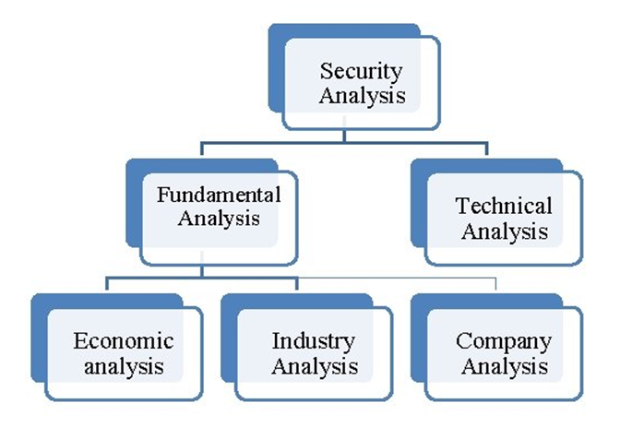
Approaches to Security Analysis

Slide 4
Intrinsic value
Intrinsic value refers to the actual value or fundamental value of a company.
The market price of the share is lower than its intrinsic value the investor would decide to buy the share as it is under price.
It is finding out to decide whether to Buy, Hold or Sell the shares/securities

Slide 5
Market Price and Intrinsic Value
If Market Price > Intrinsic Share Price= Stock is Overvalued, Hence the Recommendation here is Sell the Stock.
If Market Price < Intrinsic Share Price= Stock is Undervalued

Slide 6
Fundamental Analysis: TOP DOWN & BOTTOM UP
Top Down- It means evaluating in the following order.
1. Economy.
2. Industry.
3. Company.
Bottom-up Approach- The investor starts with specific businesses, regardless of their industry/region and economy.

Slide 7
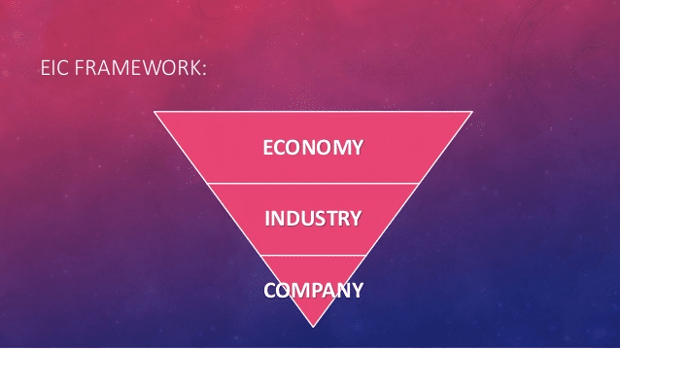
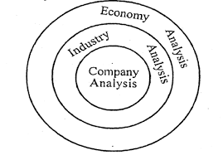
EIC Analysis of a Company

Slide 8
1-Economic Analysis
Macro in nature
Helps to understand systematic risks
To understand investment environment of a country
GDP, GNP etc
Inflation (demand side and supply side)
Interest rate
Tax structure
Budget and fiscal deficit (Export and Import)
Balance of payment
FDI & FII
Monsoon, Agriculture, demographic and cultural factors
Infrastructural facilities
Circular Flow of Fund
Notes:
These data will be available from RBI Annual Report

Slide 9
Industry Analysis
It is an analysis of homogeneous group of firms engaged in similar business.
The performance of the company depends on the performance of the industry to which it belongs.
So the industry analysis should include the fundamental factors affecting the growth prospects of the company.

Slide 10
2-Industry Analysis
Kinds of Industry
Growth (IT, Electric vehicles…..etc)
Renewable Energy
Defensive (Healthcare, Insurance)
Healthcare And Insurance
Industry/Business Life Cycle
Introduction
Growth
Maturity
Decline
Notes:
Defensive industry: Consumer demand does not decline as much during downturns.

Slide 11
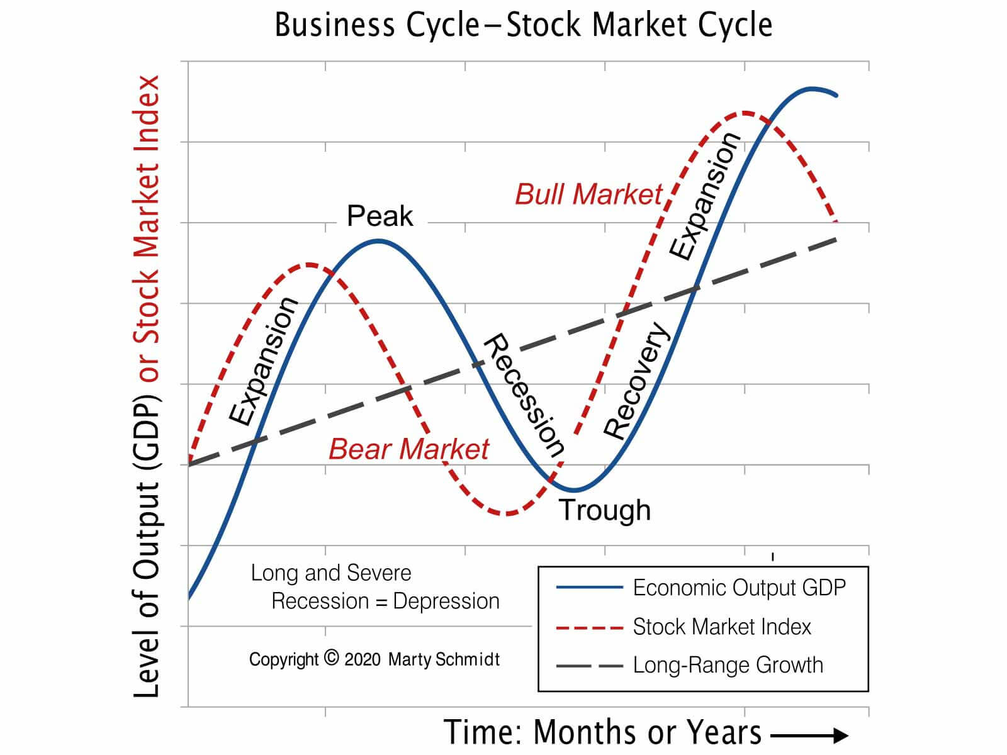

Slide 12
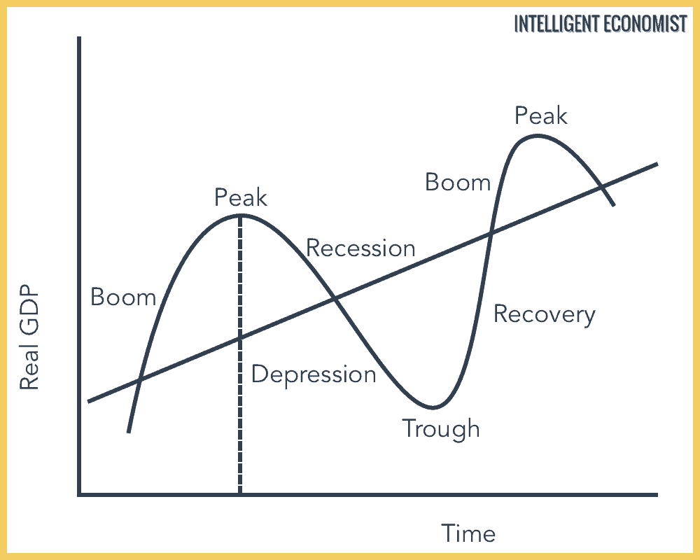

Slide 13
Company Analysis
ANALYSIS IS OF TWO TYPES:
Quantitative – It means capable of being measured or expressed in numerical terms. E.g- Ratios, Revenue, Net profit, Debt, Assets & Liab. Etc
Qualitative – It says about the quality or characteristics of few factors like Management, innovation, Brands etc.

Slide 14
Qualitative Analysis-
Background- It gives you brief idea about company’s chairman, Registered office, face value, ticker, Exchange listed, Registrar’s Name & Address etc,
History- This will let an investor to understand how a company has evolved over past.
Management- It tells us about the management their history, qualifications, experience and how they have done in past five years.
SWOT Analysis
Market performance and Potential growth- BCG Matrix

Slide 15
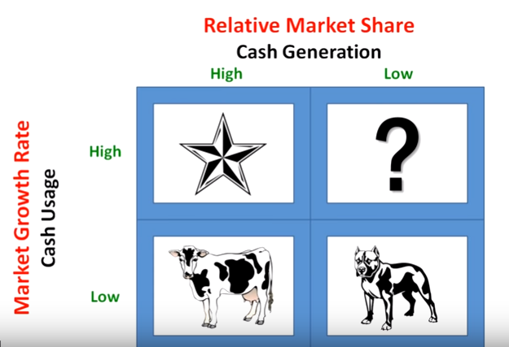
BCG Matrix

Slide 16
Stages
1. Stars
High Growth, High Market Share
2. Question Marks
High Growth, Low Market Share
3. Cash Cows
Low Growth, High Market Share
4. Dogs
Low Growth, Low Market Share

Slide 17
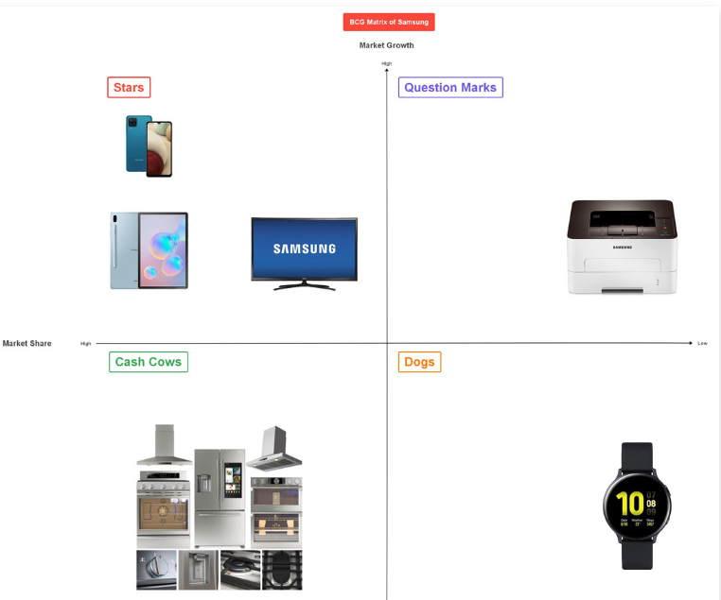

Slide 18
Quantitative Analysis

Slide 19
Key Ratios
Liquidity Ratio:- Capacity of a firm to meet its short term liability (3)
Solvency Ratios/Leverage ratios:- Ability to meet long term liability (4)
Profitability Ratios:- To measure profitability and operating efficiency of firm (7)
Turnover Ratios or Activity Ratios:- To measure firms ability to utilize its resources effectively
Market Test Ratios:- Valuation of shares (5)

Slide 20
Liquidity ratios
Liquidity Ratios are also termed as Short-Term Solvency Ratios.
The term liquidity means the extent of quick convertibility of assets in to money for paying obligation of short-term nature.
Ratios:-
1- Current Ratio, 2-Quick Ratio, 3-Cash Position ratio
S. No. | RATIOS | FORMULAS
1 | Current Ratio | Current Assets/Current Liabilities (2:1)
2 | Quick Ratio/Acid Test/Liquid Ratio | Liquid Assets/Current Liabilities (1:1)
3 | Absolute Liquid Ratio | Absolute Liquid Assets/Current Liabilities (.5:1)

Slide 21
Solvency Ratios
The term 'Solvency' generally refers to the capacity of the business to meet its short-term and long term obligations.
This solvency part discusses the Long-term obligations, which consists of debenture, long-term loans and long-term creditors etc.
Solvency Ratio indicates the sound financial position of a concern to carryon its business smoothly and meet its all obligations.
It will be expressed in fraction numbers

Slide 22
Key Ratios under solvency
(1) Debt - Equity Ratio (2:1)
(2) Proprietary Ratio
(3) Capital Gearing Ratio
(4) Debt Service Ratio or Interest Coverage Ratio

Slide 23
Profitability ratios
Gross Profit Ratio
Net Profit Ratio
Operating Ratio
Operating Profit Ratio
Based on use of investment (over all profitability)
Return on Equity (ROE)
Return on Capital Employed (ROCE)
Return on Asset (ROA)

Slide 24
Ratios based on Use of investment
ROCE, ROE, ROA

Slide 25
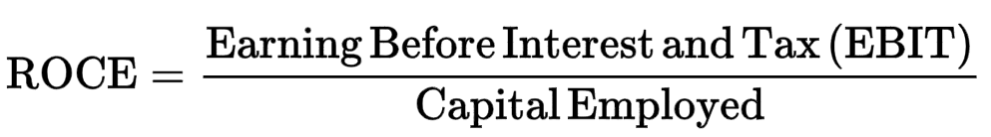
Return on Investment/ Return on Capital Employed
Capital employed =
Share Capital + Reserve and Surplus + Long term
Loans − Non-Operating Assets − Fictitious Assets
EBIT= Operating Profit
EBIT= Gross Profit- Operating Expenses
Capital Employed = Total Assets – Current Liability

Slide 26
EBIT EPS
Long term Source of fund = Capital employed
Equity - Dividend
Preference - Preference/Fixed dividend
Loans/Debentures - Interest
Reserve & Surplus
EBIT XXXXX
ROI/ROCE EBIT/CE
ROE EAIT /Equity

Slide 27
Return on Equity (ROE)
Return on equity =
Net income
Shareholder’s equity
Return on equity (ROE):- measures how the profitability of a corporation in relation to stockholders’ equity.
ROE Standard:- Around15% as an acceptable ratio, but anything less than 10% as poor.

Slide 28
Return on Assets Ratio
This ratio portrays the relationship in between the earnings and total assets employed in the business enterprise.
Return on Asset =
Net Income/Total Assets * 100
ROA measures how efficient a company's management is in generating earnings from their economic resources or assets on their balance sheet.

Slide 29
Market Test Ratio/ Valuation Ratio

Slide 30
Market Test Ratio
It is used for evaluating the shares and stock which are traded in the stock market.
It is valuation ratio of stocks in the market
Important Ratios
Earning Per Share (EPS)
Price to Earning Ratio (P/E ratio)
P/B Ratio
Dividend Per Share (DPS)
Dividend Payout Ratio (DPR) or D/P
Dividend Yield Ratio

Slide 31
Earning Per Share (EPS)
Earning After Interest and Tax
Number of Shares Issued
EAIT= Net Profit Available to equity shareholders
Calculate EPS from following Info
Equity Share Capital (Rs. 10 each) Rs. 5,00,000
10% Preference capital (Rs. 10 each) Rs. 4,00,000
Rate of tax= 50% of net profit
Net Profit before tax= Rs. 1,80,000

Slide 32
Price to Earning Ratio (P/E ratio)
P/E Ratio = (Current Market Price of a Share / Earnings per Share). P/E Ratio: MPS/EPS
This ratio gives a fair idea about potential market price of share.
This is the ratio for valuing a company’s stock (To know whether under-valued or over valued).
P/E shows what the market is willing to pay today for a stock based on its past or future earnings.
A high P/E means that a stock's price is high relative to earnings and possibly overvalued. Conversely, a low P/E might indicate that the current stock price is low relative to earnings.

Slide 33
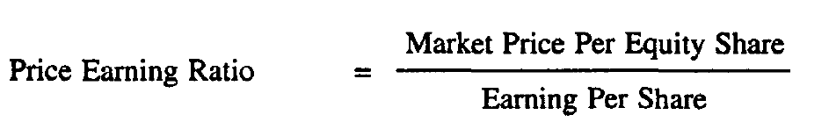
Price to Earning Ratio (PE ratio)
It signifies the amount of money an investor is willing to invest in a single share of a company for Re. 1 of its earnings.
For instance, if a company has a P/E Ratio of 20, investors are willing to pay Rs. 20 in its stocks for Re. 1 of their current earnings.

Slide 34
How P/E Ratio Calculates
Company A | Company B
Net Profit = 4,00,000 | Net Profit= 2,00,000
Number of shares= 40,000 | Number of shares= 40,000
Market Price of share= Rs. 100 | Market Price of share= Rs. 100
EPS= Net profit/N of S= 4,00,000/40,000 10 | EPS= 5
PE Ratio= 100/10= 10 | 100/5= 20
If company is in loss, then you cant calculate PE ratio

Slide 35
Undervalue and over value based on PE ratio
If PE ratio is below the five years of PE ratio (Avg PE), undervalued shared.
If current PE value is more than average PE, is called as overvalued shares
Undervalued shares to buy and overvalued shares to sell
Earnings of PE Ratio will be calculated based on last four quarters

Slide 36

4-Price to Book Value ratio (P/B ratio)
The P/B ratio measures the market's valuation of a company relative to its book value.
It is used to compare a company's current market price to its book value.
P/B ratios under 1 are typically considered solid investments.

Slide 37
Book Value
It is the amount that will remain if the company liquidates its assets and repays all its liabilities.
It is the carrying value of an asset, can be calculated as original Cost of Asset
A P/BV ratio of less than one shows the stock is undervalued (value of assets on the company's books is more than the value the market is assigning to the company).
Book value = Total Assets – Total Liabilities
Fair Value: Market value of an asset determined by the buyer and seller (Intrinsic value)
Book value of an asset = total cost - accumulated depreciation.
Book value of a company = assets - total liabilities.

Slide 38
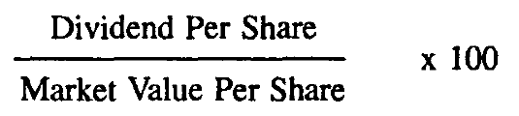
Dividend Yield Ratio
This ratio measures the quantum of cash dividends paid out to shareholders relative to the market value per share.
When the dividend remains the same if the share price drops, the dividend yield rises. The yield will fall if the stock price rises.
It is computed by dividing the Dividend Per Share (DPS) by the Market Price Per Share (MPS) and multiplying the result by 100.

Slide 39
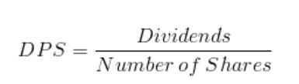
Dividend Per Share (DPS)
It is calculated by dividing total amount of dividend distributed by number of shares
Total dividend amount out of profit= 10,00,000
Equity Share Capital (Rs. 10 each) Rs. 20,00,000
DPS= 10,00,000/2,00,000= 5

Slide 40
Technical Analysis

Slide 41
Technical Analysis
A study of past or historical price and volume movement so as to predict the future stocks price behavior.
It will help to understand trends or movement of shares
Technical Analysis will help to make decisions on when to buy and sell
Timing of investment is vital importance for trading in the stock market
Technical analysis is based on the assumption that the value of a stock is dependent on demand and supply factors.

Slide 42
Where to apply Fundamental and Technical Analysis
From Investors point of view
What to buy: Fundamental analysis
When to buy and sell (trade): Technical analysis
Speculators mostly depend on Technical analysis and risk-return analysis.
The technical tools are expressed in the form of charts which compare the price and volume relationships.

Slide 43
Trend is your friend

Slide 44
IMPORTANT CHART PATTERNS
Candle Stick
Line chart
BAR chart
Charts are used to find out the total broad spectrum of the market

Slide 45
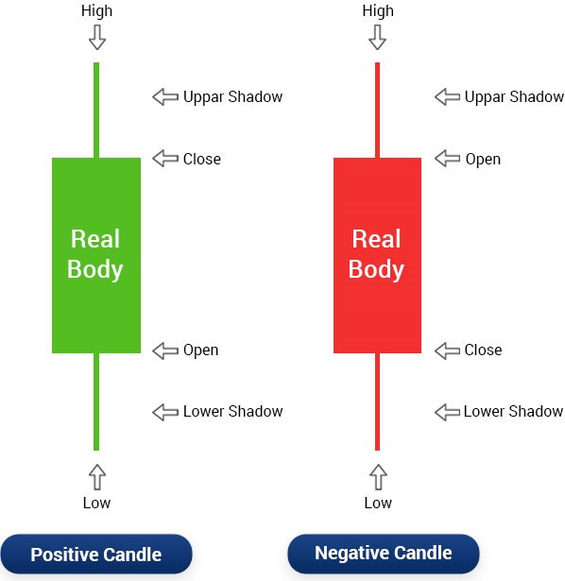
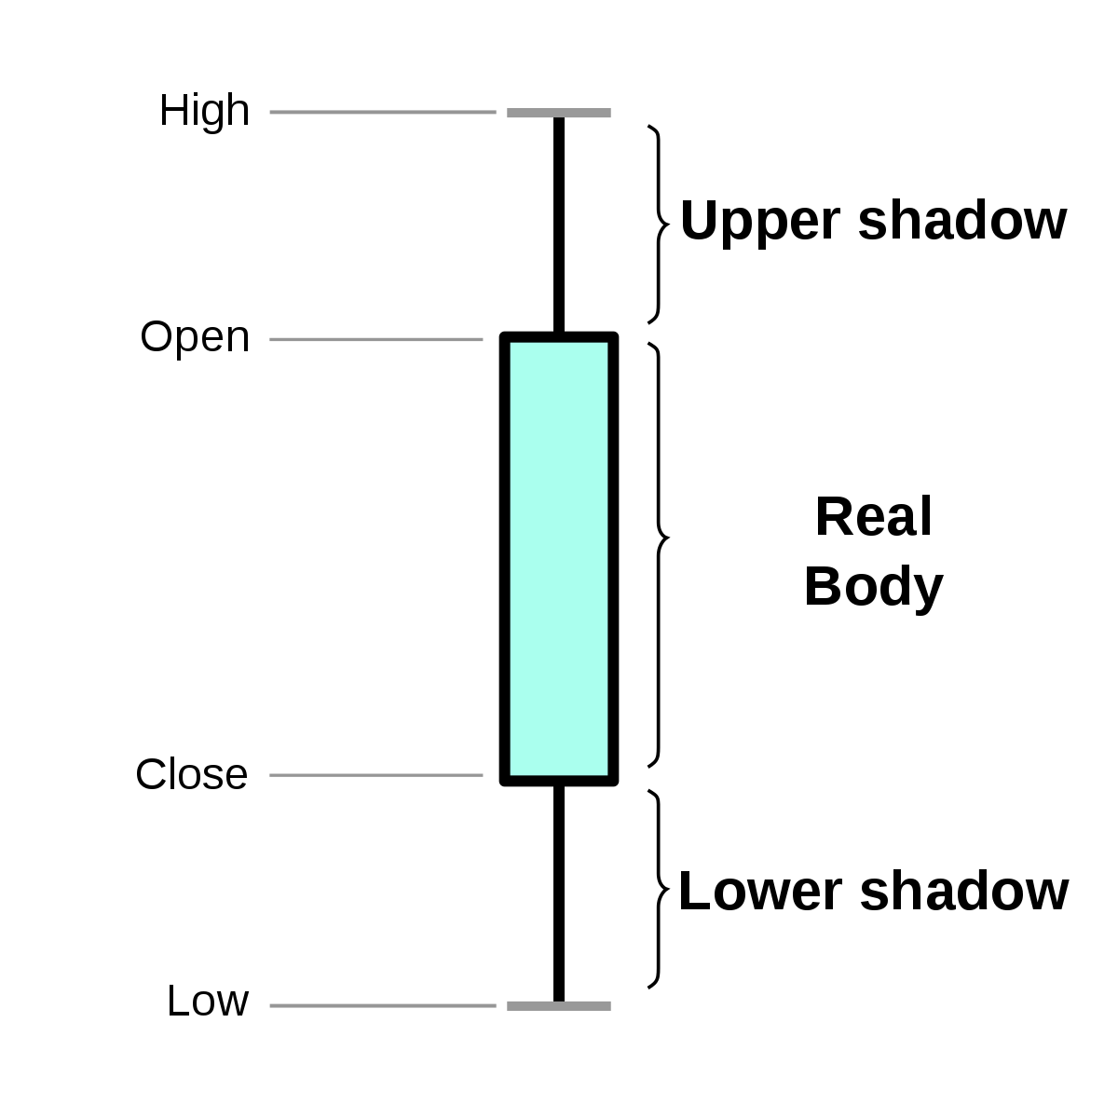
Candlestick Chart
Notes:
https://in.investing.com/equities/reliance-industries-chart

Slide 46
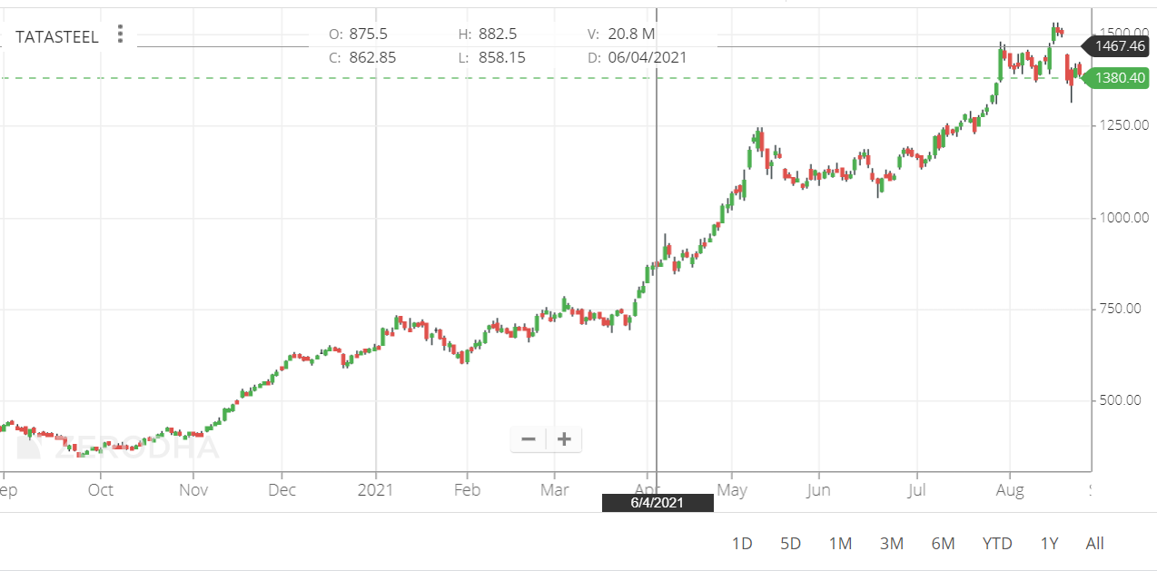
Candle Stick

Slide 47
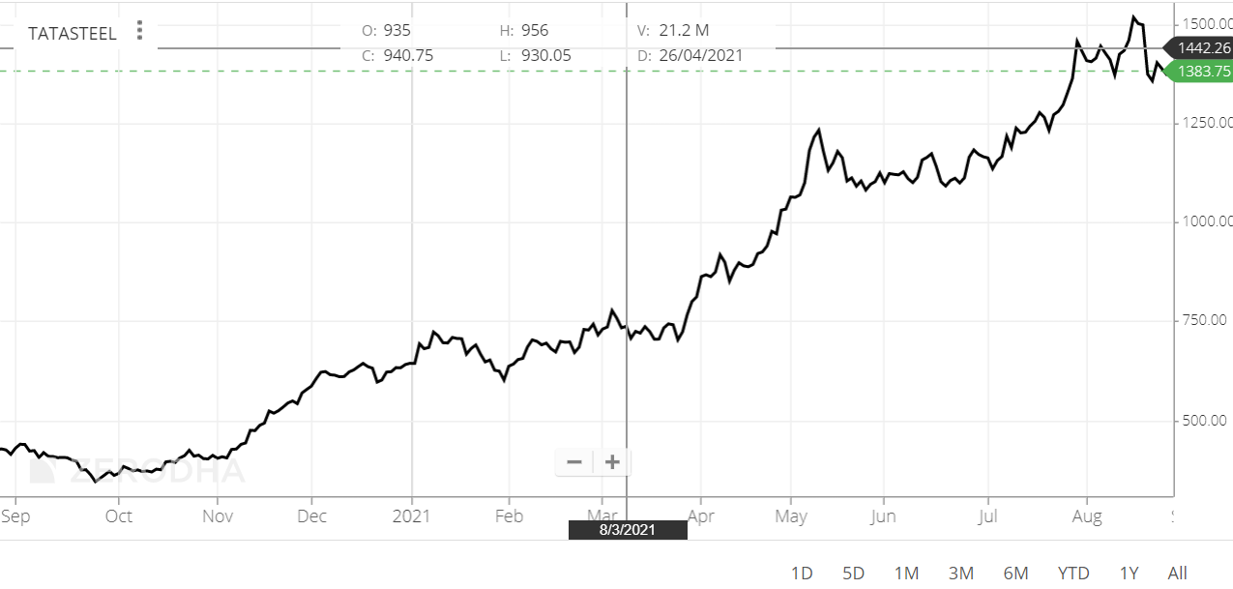
Line Chart
Line chart is formed by plotting a stock’s closing prices.
A line chart can be used to interpret trends, but no other information can be derived

Slide 48
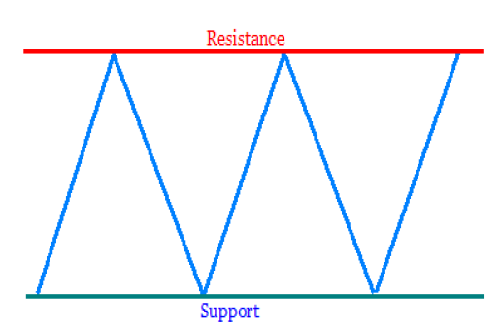
SUPPORT AND RESISTANCE
The support and resistance (S&R) are specific price points on a chart expected to attract the maximum amount of either buying or selling.
The support price is a price at which one can expect more buyers
Resistance price is a price at which one can expect more sellers than buyers.

Slide 49
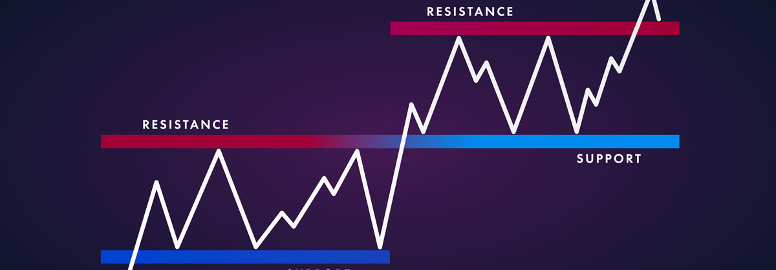
Support
Support occurs where a downtrend is expected to pause.
Resistance occurs where an uptrend is expected to pause
Notes:
https://www.ig.com/en/trading-strategies/support-and-resistance-levels-explained-181219

Slide 50
Dow Theory
1) Primary / main movements (Tide)
2) Secondary reaction/ correction movement (wave)
3) Minor / narrow movements (Ripple)

Slide 51
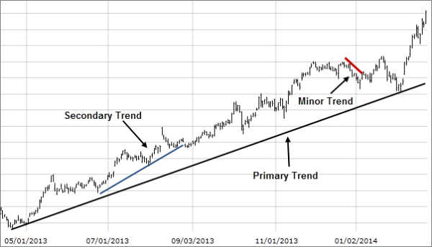

Slide 52
Three movements of market… (Dow theory)
Ripple (Narrow Movement):-This is the daily variation due to local causes
Wave (Short Movement)/Secondary trend :- Ranging from days to weeks (averaging between six to eight weeks)
Tide (Primary Movement):-The third move is the great swing covering anything from months to years, averaging between 6 to 48 months (4 yrs)

Slide 53
Oscillators/ Indicators
Mathematical indicators based on closing price data to identify overbought and oversold conditions in a ranging market.
Also called as Momentum Oscillators/Indicators
Major Indicators
RSI (Trend confirmation)
Stochastic oscillator (Identifying overbought and oversold levels)
Moving Average (Detecting Momentum)
MACD
Notes:
Stochastics oscillates between two fixed values, 0 and 100

Slide 54
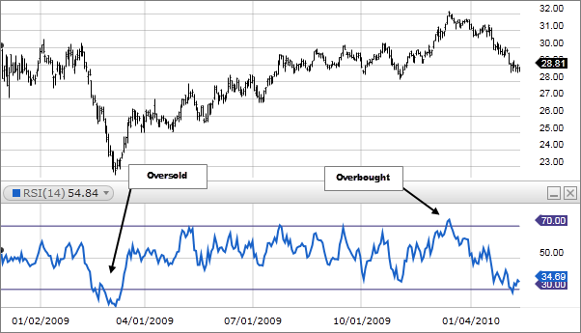

Slide 55
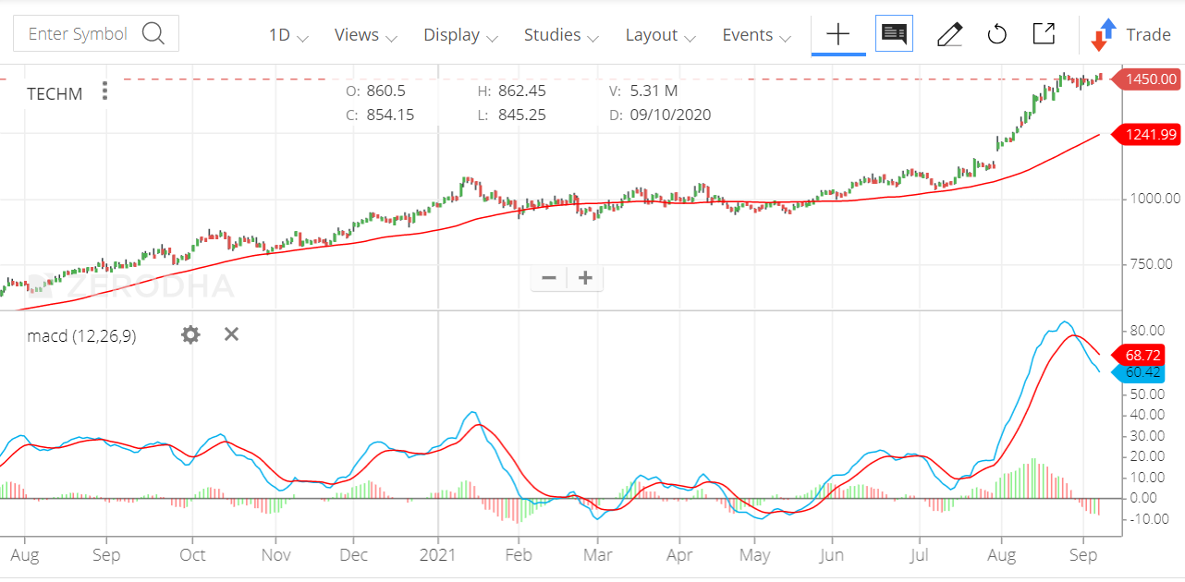
MACD of TECHM

